Slide 1
RFP No. PPP02/2024-25
IN RESPECT OF kosi bay TOURISM RESORT IN THE kosi bay SECTION OF THE iSIMANGALISO WETLAND PARK
BIDDERS CONFERENCE MEETING
09 May 2025

Slide 2
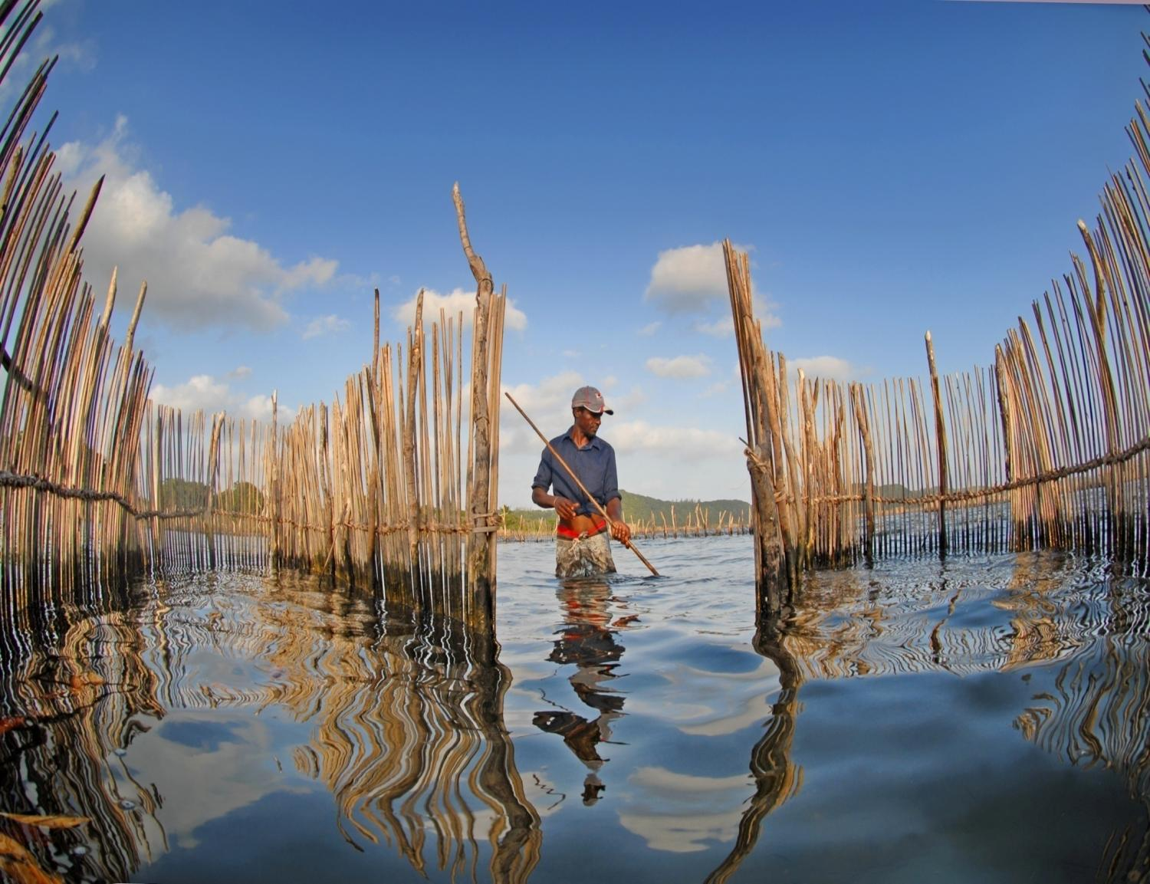
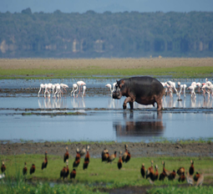
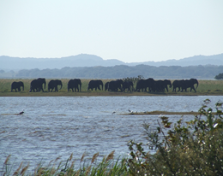
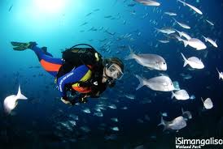
AGENDA
# | Description | Presenter
1. | Welcome & Opening | Project Officer
2. | Time for Bidders Conference (14H00 – 15H30) | Project Officer
3. | Introduction of iSimangaliso Team | Project Officer
4. | Purpose of the Bidders Conference | Project Officer
5. | Rules of Engagement | Project Officer
6. | Overview of iSimangaliso Wetland Park | Project Officer
7. | Vision ,Mission and Objective | Project Officer
8. | Commercialisation Strategy Objectives of iSimangaliso | Project Officer
9. | PPP Opportunity Presentation | Transaction Advisor
10. | Bidding Process Presentation | Transaction Advisor
11. | Bidding Time Table | Transaction Advisor
12. | Question & Answer Session | Project Officer
13. | Closure | Project Officer
uKhahlamba WHS
Notes:
Allocated time is 2 minutes

Slide 3
Purpose of the Bidders Conference
To clarify the tender process to the bidders
To ensure bidders understand what needs to be submitted
To outline the evaluation criteria
To outline the Bidding Time Table
Notes:
Allocated time is 1 minute

Slide 4
Rules of Engagement
All presentations made will be uploaded on iSimangaliso website
Questions can be posted on the chat-box during the presentation
Questions will be addressed during question and answer session
Questions must be specific to the bid under tender
iSimangaliso reserves the right to answer questions at a later stage
All bidders to type in the chat-box, Name of Representatives, Company Name & Email Address
All mics of the bidders to be on mute until Q&A session
Notes:
Allocated time is 1 minute

Slide 5
Overview
uKhahlamba WHS
Notes:
This section is allocated 5 minutes

Slide 6
Overview of iSimangaliso Wetland Park
iSimangaliso Wetland Park of the iSimangaliso Wetland Authority was proclaimed a World Heritage Site by regulation published in the Government Gazette under notice number 4477 on 24 November 2000.
The total area of new iSimangaliso MPA(Marine Protected Area) 1 328 901 ha and comprises 9% of South Africa's coastline under formal conservation hectares in size.
The Indian Ocean forms the eastern boundary of the Park, which extends from the Mozambican border in the north, to Maphelane in the south and includes the uMkhuze section in the west.
The Park traverses approximately one-third of the KwaZulu-Natal coastline
Notes:
Allocated time is 1 minute

Slide 7
Vision, Mission and Objectives
Vision
Mission
Objective
To protect, conserve, and present the Park
To promote and facilitate optimal tourism and related development in Park
To encourage job creation and ensure benefit flow to communities
To financial sustainability.
A renowned World Heritage Park where wonders never End.
To be a World Heritage Site celebrated for its sustainable conservation practices, offering unparalleled experiences and equitable sharing of benefits. Through applying sustainable commercialisation practices, biodiversity conservation and community development to protect, preserve and present iSimangaliso Wetland Park for local and global appreciation.
Notes:
Allocated time is 2 minute

Slide 8
Commercialisation Strategy Objectives of iSimangaliso
Objectives that guide the iSimangaliso’s commercialisation strategy include:
Revenue generation for the institution
Loss minimization or savings on existing operations
Optimal utilization of under-performing assets
Job creation
BEE/ Transformational goals.
Infrastructure upgrades
Tourism promotion
Further biodiversity protection and conservation
Notes:
Allocated time is 2 minutes

Slide 9
PPP Opportunity
uKhahlamba WHS
Notes:
This section is allocated 6 minutes

Slide 10
PPP Opportunity
Contents:
Introduction
Project Objectives
PPP Opportunity
Question & Answers
uKhahlamba WHS
Notes:
Allocated time is 30 seconds

Slide 11
Introduction
In the Kosi Bay section of the Park, Kosi Bay Resort is located as one of the ten duels;
Kosi Bay is known for its pristine beaches, coastal forests, and vibrant birdlife;
iSimangaliso intends to procure investors to redevelop and operate the resort on a PPP basis,
Located on the coast in the top north-east corner of Kwa-Zulu Natal and forms part of the Park;
Kosi Bay is approx. 440 km from Durban and 160 km from Maputo;
Approx. 20 km from the Kosi Bay Mouth Beach;
Home to a large variety of birds and animals including hippopotamus and crocodile;
Kosi bay is made up of six large lakes, two smaller lakes and one conserved estuary on the Indian Ocean coastline;
Offers 15 shady open campsites that can accommodate 7 guests each;
Each site has running water, barbecue facilities and a plug point.
Notes:
Allocated time is 1 minute

Slide 12
Introduction
An existing concession area;
The site is a 2x4 access, via manned Kosi Bay access control gate;
The access road is tarred;
All access gates into the Wetland Park are controlled and managed by iSimangaliso;
The Resort comprise of the following:
# | Description | Quantity
1. | 5 Bed Unit - Lodge | 1
2. | 6 Bed Unit - Lodge | 1
3. | 2 Bed Unit - Chalets | 1
4. | Camping sites with power | 5
5. | Camping sites without power | 10

Slide 13
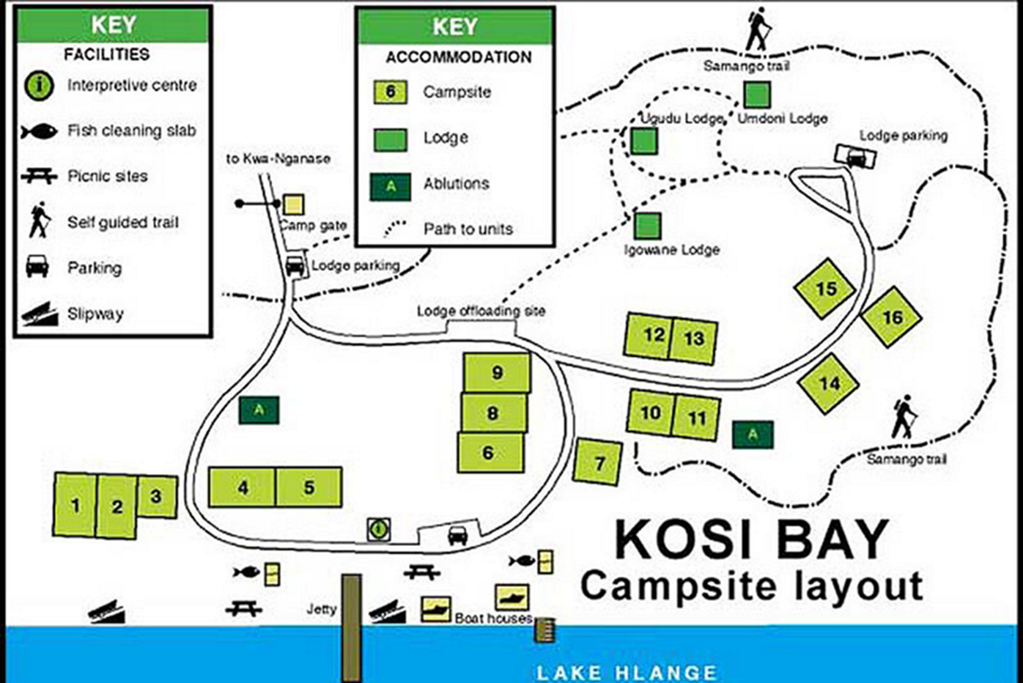
Introduction
Layout of Kosi Bay Resort
Notes:
Allocated time is 1 minute

Slide 14
Project Objectives
Undertake a PPP for the resort using the Toolkit for Tourism
Compliance with the PFMA, World Heritage Act, and other prescripts of the law.
Efficient use of the project site
Enhance the attractiveness of the resort, increase tourist traffic and stay
Facilitate and fast track the redevelopment of facilities at the resort,
Ensure increased tourist numbers
Contribution to increased revenue within the Park.
Redevelop and upgrade facilities to support interpretation and enhance visitor experience.
Improve visitor’s experience at an attractive destination and generate revenue within the Park.
Redevelop and upgrade facilities that to provide 4-star lodge facilities.
Support conservation management
Notes:
Allocated time is 2 minutes

Slide 15
PPP Opportunity
iSimangaliso is inviting proposals through this RFP for the redevelopment of the Kosi Bay resort.
Redevelopment to be a design, build, finance, operate and transfer (DBFOT) PPP and should deliver an attractive 4-star resort and tourist destination,
Redevelopment is envisaged to be undertaken on a brownfield project site,
Project Contract Term is twenty (20) years, including a development period of one (1) year and operations period of nineteen (19) years.
Notes:
Allocated time 2 minutes

Slide 16
PPP Opportunity
Bidders are required to submit their own comprehensive proposals which will include:
Demand & revenue assessment,
Financial & capital plans including a comprehensive financial model, NPV, IRR, ROI etc,
Financial model to be submitted in an editable format i.e. MS Excel.
Value for money outputs,
Risk management plan including a risk matrix,
Business & operations plans including maintenance plan,
Environmental plans,
Marked-up PPP agreement,
Notes:
Allocated time 2 minutes

Slide 17
Bidding Process
uKhahlamba WHS
Notes:
This section is allocated 10 minutes

Slide 18
Bidding Process
Contents:
RFP Document
Bidding Time-Table
Evaluation Criteria
Bid Submission
Procurement Process
Question & Answers
uKhahlamba WHS
Notes:
Allocated time is 30 seconds

Slide 19
RFP Document
Background Information
Legal, Regulatory & Institutional Framework
Integrated Management Plan
iSimangaliso Commercialisation Strategy
Value For Money Objectives
B-BBEE/Transformation
The PPP Kosi Bay Tourism Resort PPP Project Opportunity
Utilities And Facilities Management
Concession Agreement
Bid Rules
Disqualification
Incomplete Bids
Bid Process Information
Site Visits
Bid Submission
Content And Submission Of Bids
How The Bids Will Be Opened
Evaluation Criteria
Scoring for Functionality (Envelope 1)
PPP Fee Offer & B-BBEE Project Scorecard Commitment/Specific Goals (Envelope 2)
Selection of Preferred Bidder
Signature & Effectiveness Of Concession Agreement
Bond (Bid And Performance Bond)
Publicity
Funding for Tourism Development
Information Pack for Bidders
Prequalification & Mandatory Requirements
List of Annexure
1: Information Required
2: Evaluation Criteria
3: B-BBEE/ Specific Goals Obligations
4: PPP Offer
5: Concession Agreement
6: Cover Page and Declaration Form
7: Form of Suretyship
8: Environmental Declaration
9A: Map of the Park
9B: Project Site Layout
9C: Description of Project Site
10: Park Zonation
11: Wording of the Performance Bond
12: Park and Activity rules
13: Compulsory Checklist
14: Integrated Management Plan
Notes:
Allocated time is 2 minutes

Slide 20
Bidding Time-Table
Event | Date
Advertising and RFP issued | 28 Mar 2025
Registration for Due Diligence Site Visits. RSVPs to be emailed to: ppp@isimangaliso.com | 3 Apr to 17 Apr 2025
Due Diligence Site Visits | 24 Apr to 09 May 2025
Registration for Bidders Conference. RSVPs to be emailed to: ppp@isimangaliso.com | 05 May to 09 May2025
Bidders Conference (Platform to be advised) | 09 May 2025
Questions of clarification - closing date | 30 May 2025
Feedback of Questions of clarification | 06 June 2025
Bid submission closing date | 23 June 2025 (12H00)
Notes:
Allocated time is 2 minutes

Slide 21
Evaluation Criteria
Tender is based on 90/10 system
Evaluation criteria will be conducted on the following:
Prequalification – Compliance documentation for the SPV
Functionality – Minimum threshold is 70%
PPP Fee Offer and B-BBEE commitments/Specific goals
Marked-up PPP Agreement
Elements | Financing & Capital Plan | Business & Operational Plan | Environmental & Green Proposal | Risk Matrix
Weight | 30% | 40% | 20% | 10%
Minimum Threshold | 50% | 50% | 50% | 50%
PPP Offer | B-BBEE Commitment/ Specific Goals
90% | 10%
Notes:
Allocated time is 2 minutes

Slide 22
Bid Submission
Bids must be submitted to:
The Official Bid Representative
The iSimangaliso Wetland Park Authority
The Dredger Harbour
St Lucia 3936
Bid Submissions should be made before 12h00 on 23 June 2025
Bidders must submit their bids in two sealed envelopes, clearly marked envelopes 1 and 2.
One original and three hard copies, and one electronic copy of the Bid must be submitted
Financial model must be in an editable format, preferably Microsoft Excel,
The bid validity period for this RFP is 120 days
Bidders to continuously check for updates of bid on the website
Presentation and answers to the questions will be uploaded on the website
Notes:
Allocated time is 1 minute

Slide 23
Procurement Process
PROCUREMENT PHASE
4 STAGES
(Toolkit for Tourism)
Stage 1: RFP & Institution Approval: IIA
Stage 2: Evaluate Bids, Select the Preferred Bidder, Institution Approval: IIB
Stage 3: Negotiations
Stage 4: Institution Approval: III & Sign the PPP agreement
uKhahlamba WHS
Notes:
Allocated time is 1 minute

Slide 24
After Bid Closes – Tentative Dates
Event | Date
RFP Tender Closing Date | 23 June 2025 (12pm)
Bid Evaluation | 21 July 2025
Negotiations | 21 July – 18 Aug 2025
Signing of PPP Agreement | 15 Sept 2025
uKhahlamba WHS
Notes:
Allocated time is 1 minute

Slide 25
Thank you
uKhahlamba WHS

